Slide 1
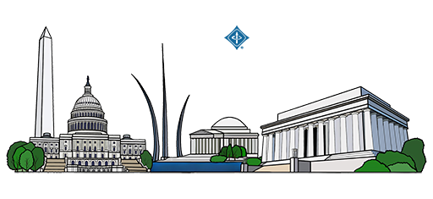
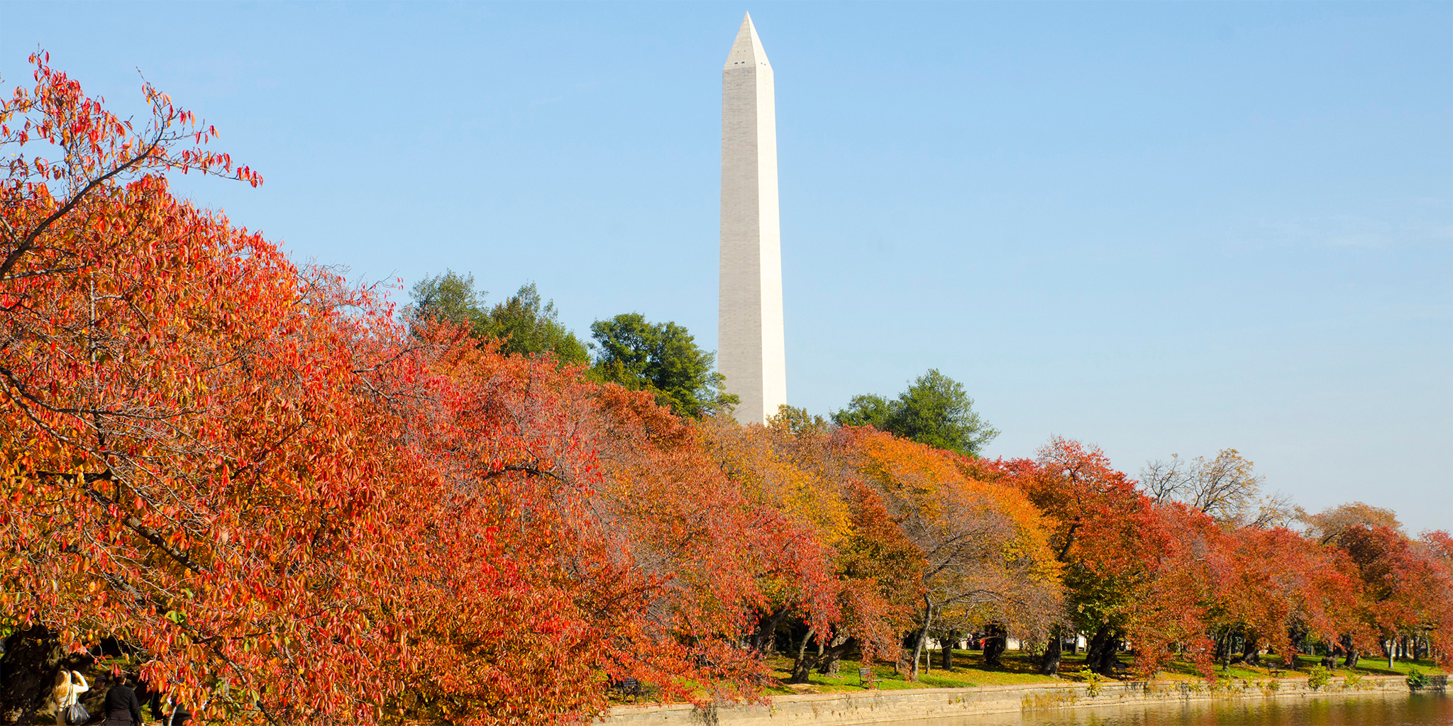
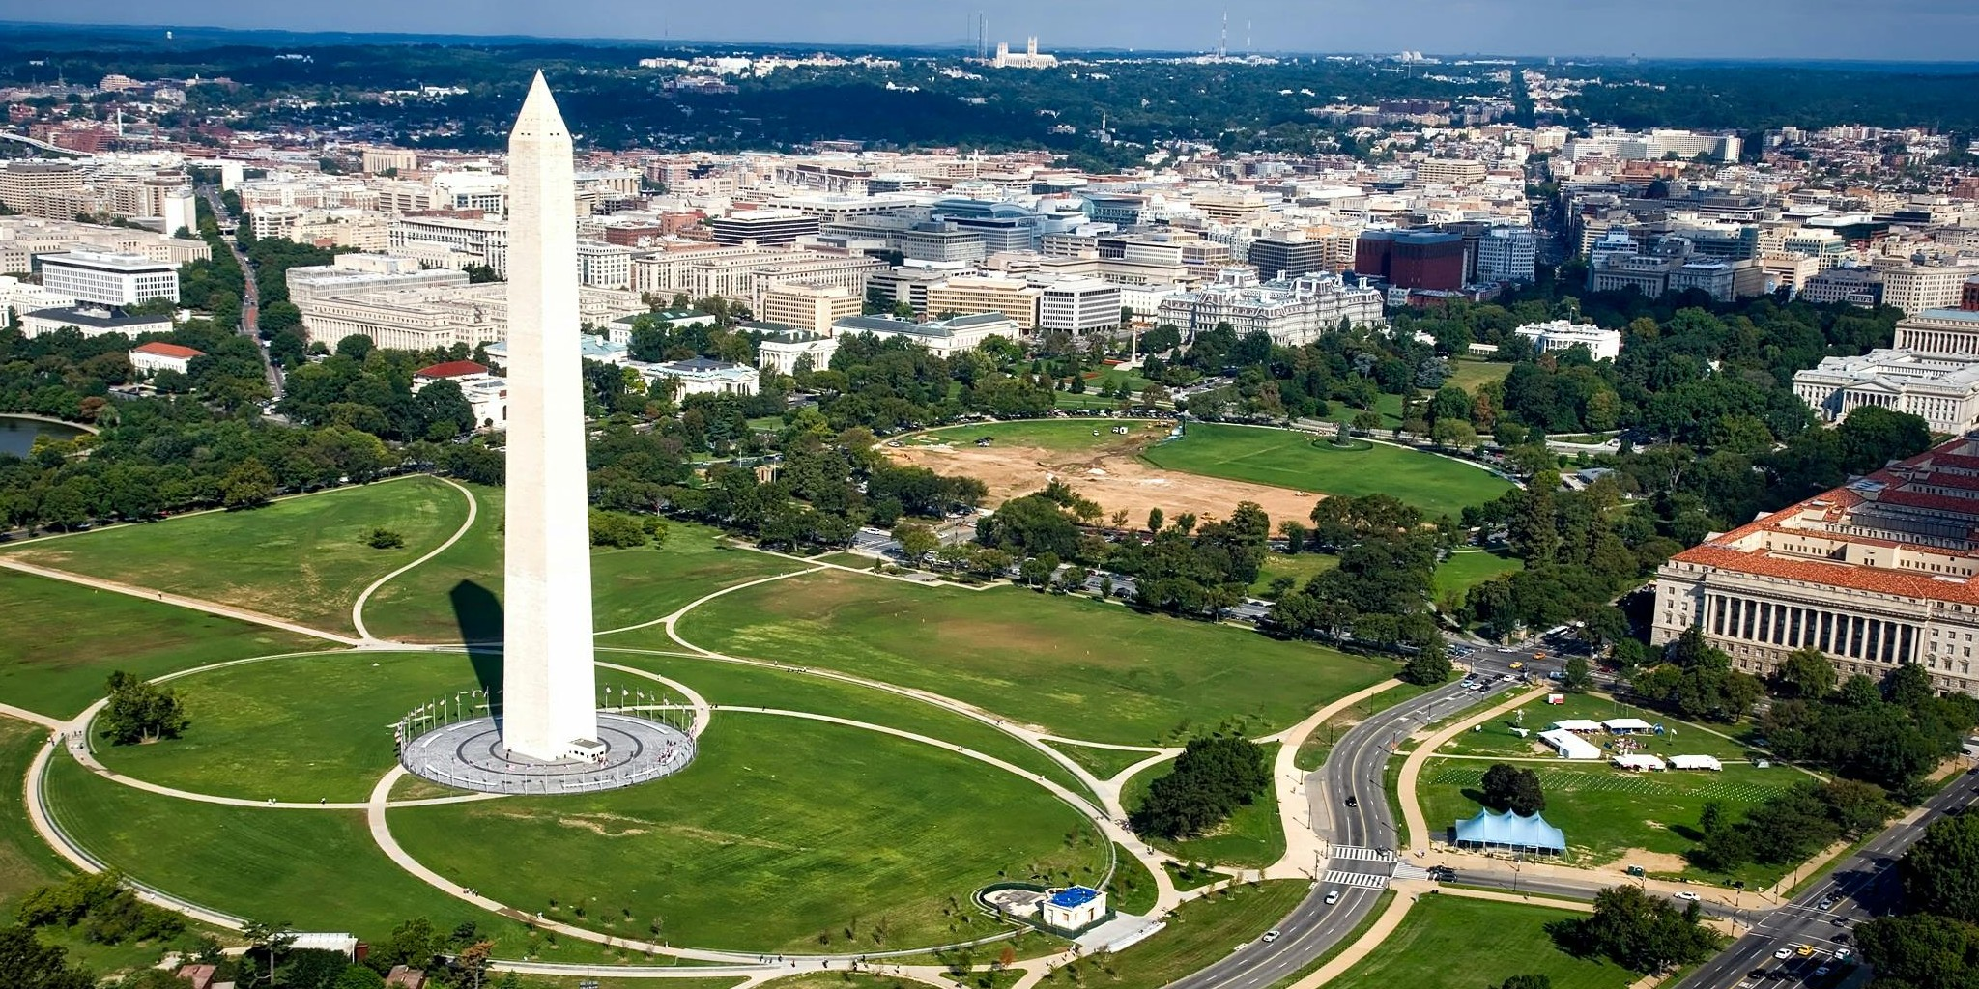


DMAIL 2025: The First International Workshop on Data Mining and AI for Law
Haihua Chen, University of North Texas, USA
Ken Satoh, National Institute of Informatics, Japan
Nguyen Ha Thanh, National Institute of Informatics, Japan
Joel Niklaus, University of Bern, Switzerland
Yang Zhang, University of North Texas, USA
Sabine Wehnert, Otto von Guericke University Magdeburg, Germany
Jiangping Chen, University of Illinois Urbana-Champaign, USA
Updated on Nov 14th, 2025

Slide 2
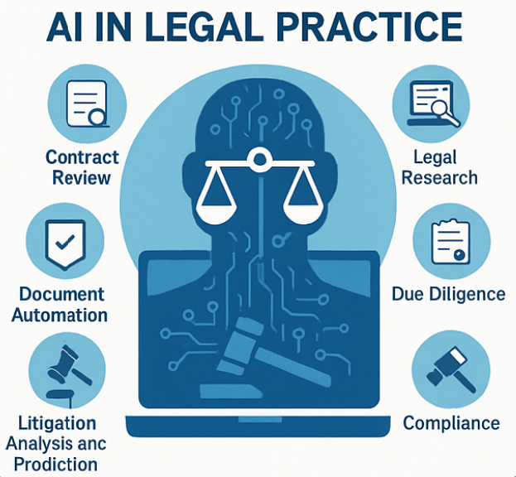
Introduction
Theme
Organizers
PC Members
Program
Future
Why Data Mining & Al for Law Matters
Massive data + complex law = opportunity & challenge. Legal data is vast, unstructured, and dynamic.
AI and data mining unlock new capabilities in legal analytics and decision support.
Efficiency, insight, and transparency drive the transformation of legal practice.
Ethical, trustworthy, and explainable AI ensures fairness and accountability in law.
Image generated with ChatGPT, 2025

Slide 3
Introduction
Theme
Organizers
PC Members
Program
Future
Core Themes of DMAIL 2025
Large-scale and high-quality datasets for legal DM and Intelligence
Predictive modeling of court decisions
AI-assisted legal reasoning and judgment prediction
Legal document classification and question answering
Case law retrieval and citation analysis
Argument mining and reasoning in legal discourse
Knowledge graph for legal DM
Legal text generation and summarization using LLMs
Chatbots and virtual legal assistants
AI-enhanced legal research tools
Applications of DM/AI for legislative and policy analysis
Ethical and social implications of in AI for law
Addressing bias mitigation and fairness of AI for law
Explainability and security in legal AI applications

Slide 4
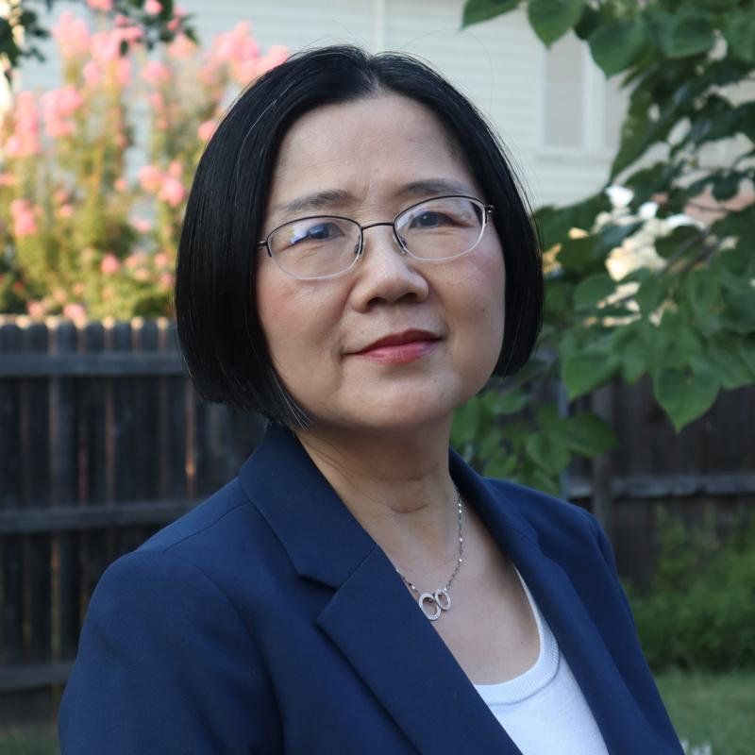
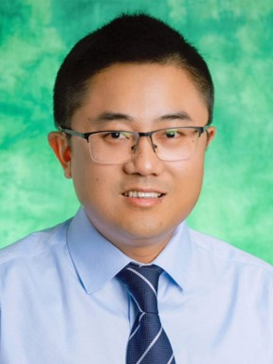
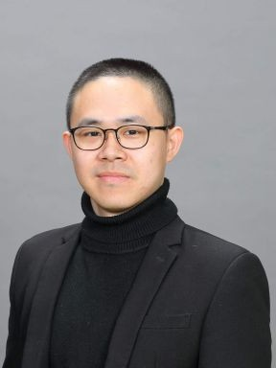
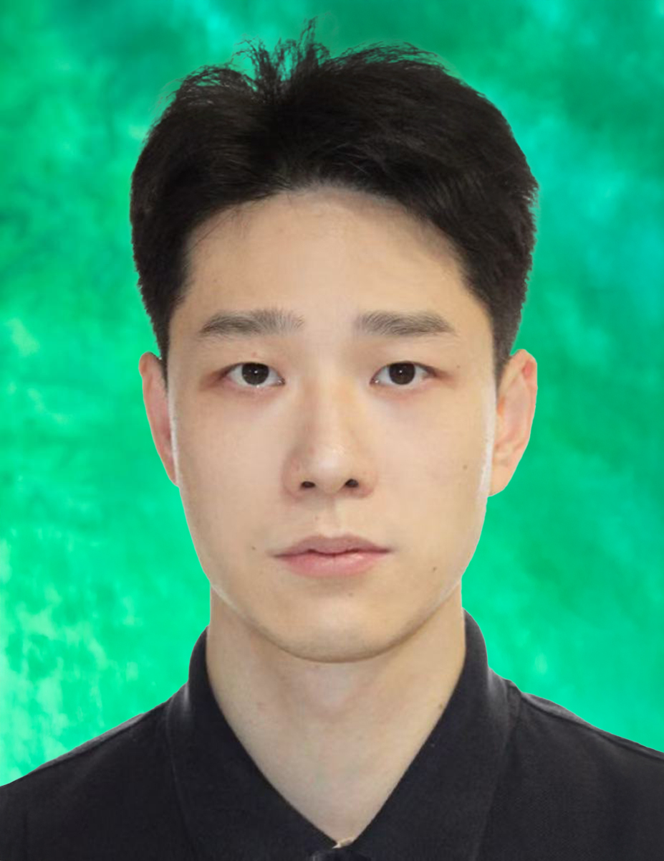
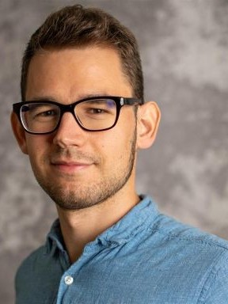
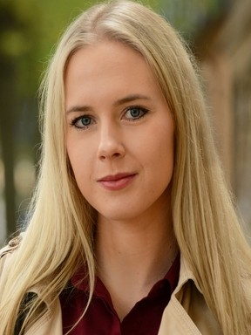
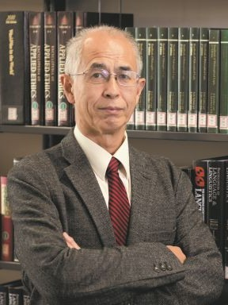
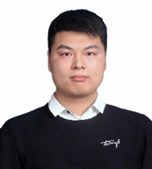
Introduction
Theme
Organizers
PC Members
Program
Future
Organizing Committee
Jiangping Chen Local chair
Haihua Chen
Co-chair
Nguyen Ha Thanh
Co-chair
Yang Zhang Co-chair
Ken Satoh
Co-chair
Joel Niklaus Co-chair
Sabine Wehnert
Co-chair
Haoxuan Zhang
Website chair

Slide 5
Introduction
Theme
Organizers
PC Members
Program
Future
Program Committee (37 members from 13 countries)
Frank Schilder, Thomson Reuters Labs, USA
May Myo Zin, Center for Juris-Informatics, ROIS-DS, Tokyo, Japan
Minh-Phuong Nguyen, Japan Advanced Institute of Science and Technology, Ishikawa, Japan
Thi-Hai-Yen Vuong, VNU University of Engineering and Technology, Vietnam National University, Hanoi, Vietnam
Vu Tran, Japan Advanced Institute of Science and Technology, Ishikawa, Japan
Wachara Funwacharakorn, Center for Juris-Informatics, ROIS-DS, Tokyo, Japan
Pedro Miguel Freitas, Universidade Católica Portuguesa, Portugal
Sarah Ryan, University of North Texas, USA
Yuki Todo, Kanazawa University, Japan
Jiangping Chen, University of Illinois Urbana-Champaign, USA
Karolina Naranjo-Velasco, University of Virginia, USA
Manuel Fiorelli, Università degli Studi di Roma Tor Vergata, Italy
Ilaria Angela Amantea, University of Turin, Italy
Reshma Sheik, National Institute of Technology, India
Ankita Gupta, University of Massachusetts Amherst, USA
Yoshinobu Kano, Shizuoka University, Japan
Masaharu Yoshioka, Hokkaido University, Japan
Marco Siino, University of Catania, Italy
Jaromir Savelka, Carnegie Mellon University, USA
Kripabandhu Ghosh, Indian Institute of Science Education and Research, India
Xuran Wang, University of Pennsylvania, USA
David Lillis, University College Dublin, Ireland
Tomasz Zurek, University of Amsterdam, Netherlands
Huihui Xu, University of Pittssburgh, USA
Prakash Poudyal, Kathmandu University, Nepal
Mi-Young Kim, University of Alberta, Canada
Zhuoren Jiang, Zhejiang University, China
Manuel Fiorelli, University of Rome Tor Vergata, Italy
Emilio Sulis, University of Torino, Italy
Abe Bohan Hou, Johns Hopkins University, USA
Andrea Tagarelli, University of Calabria, Italy
Colin Doyle, Loyola Law School, Los Angeles, USA
Ruta Liepina, University of Bologna, Italy
Aamir Abdullah, University of Hawai'i at Manoa, USA
Yue Zhang, University of Texas at Dallas, USA
Jack Mumford, University of Liverpool, England
Michał Araszkiewicz, Jagiellonian University, Poland

Slide 6
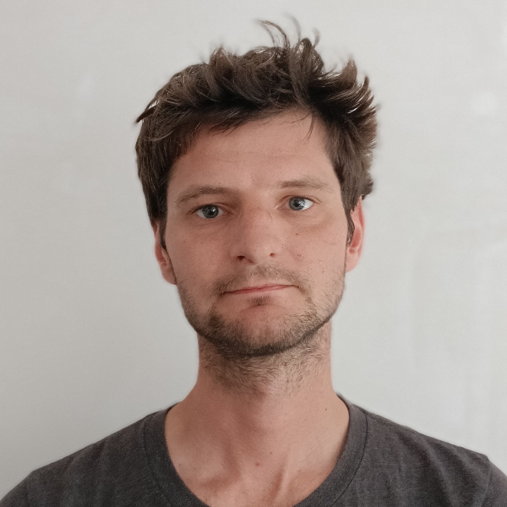
Introduction
Theme
Organizers
PC Members
Program
Future
Keynote
Dominik Stammbach
Postdoctoral Research Associate
CITP, Princeton University
USA
Title: How Can AI Strengthen Indigent Defense? Evidence from Qualitative Interviews and a Collaboration with a Public Defender's Office

Slide 7
Introduction
Theme
Organizers
PC Members
Program
Future
Accepted Papers (12 reviewed 5 accepted)
Sarah Ryan and Lingzi Hong, "The Challenges of Data Mining and A.I. for State Laws and Legislative Research: Recommendations for the Development of Legislative A.I."
Jieh-Sheng Lee, "PatentGRPO: Group Relative Policy Optimization for Patent Text Generation"
Moriya Dechtiar, Daniel Martin Katz, Mari Sundaresan, Sylvain Jaume, and Hongming Wang, "GRAPH-GRPO-LEX: Legal Contracts Graph Modeling via Reinforcement Learning with Group Relative Policy Optimization"
Steve Huntsman, "Automatic Coherence-driven Inference on Arguments"
M. Mikail Demir and M. Abdullah Canbaz, "Legal Argument Mining the TCA’s Technology Undertaking Exception with Turkish BERT"

Slide 8
Introduction
Theme
Organizers
PC Members
Program
Future
Session Schedule
Time slot | Activity (Moderator: Prof. Jiangping Chen) | Speaker
1:30pm ~ 1:40pm | Opening | Prof. Jiangping Chen
1:40pm ~ 2:30pm | Keynote Speech | Dr. Dominik Stammbach
2:40pm ~ 3:30pm | Paper Session 1
 | The Challenges of Data Mining and A.I. for State Laws and Legislative Research: Recommendations for the Development of Legislative A.I. (25 minutes) | Sarah Ryan
 | PatentGRPO: Group Relative Policy Optimization for Patent Text Generation (25 minutes) | Jieh-Sheng Lee
3:30pm ~ 4:00pm | Coffee Break
4:00pm ~ 5:15pm | Paper Session 2
 | GRAPH-GRPO-LEX: Legal Contracts Graph Modeling via Reinforcement Learning with Group Relative Policy Optimization (25 minutes) | Moriya Dechtiar
 | Automatic Coherence-driven Inference on Arguments (25 mintues) | Steve Huntsman
 | Legal Argument Mining the TCA’s Technology Undertaking Exception with Turkish BERT (25 minutes) | M. Mikail Demir
5:15pm ~ 5:25pm | Closing | Prof. Jiangping Chen
Program website: https://dmail-workshop.github.io/DMAIL2025/program/

Slide 9
Introduction
Theme
Organizers
PC Members
Program
Future
The Future of AI & Law
Law-as-Data: Integrating structured and unstructured legal data for intelligent systems.
AI-Augmented Legal Practice: Decision support, compliance, and digital justice.
Cross-disciplinary Collaboration: Bringing together data scientists, legal scholars, and policymakers.
Global Impact: Building trustworthy AI to strengthen fairness and access to justice worldwide.

Slide 10
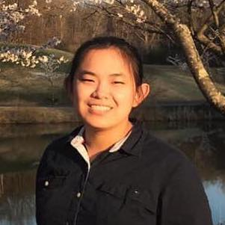
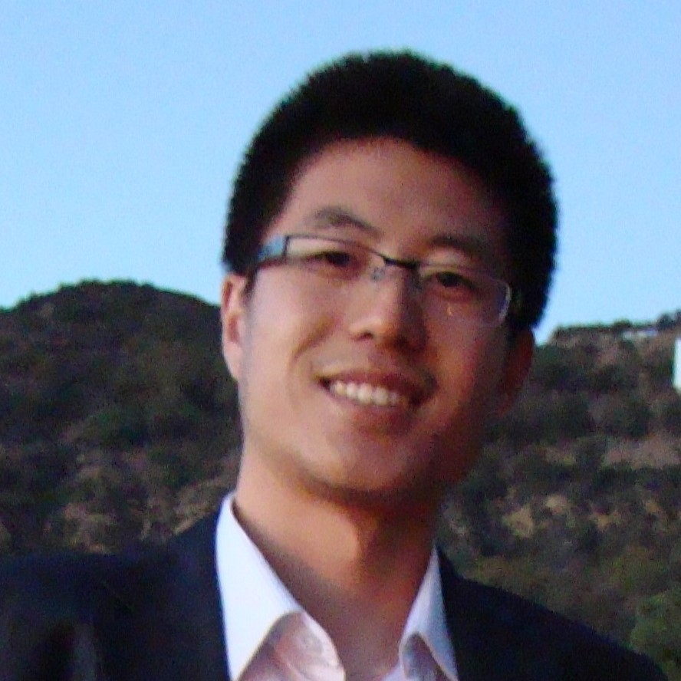
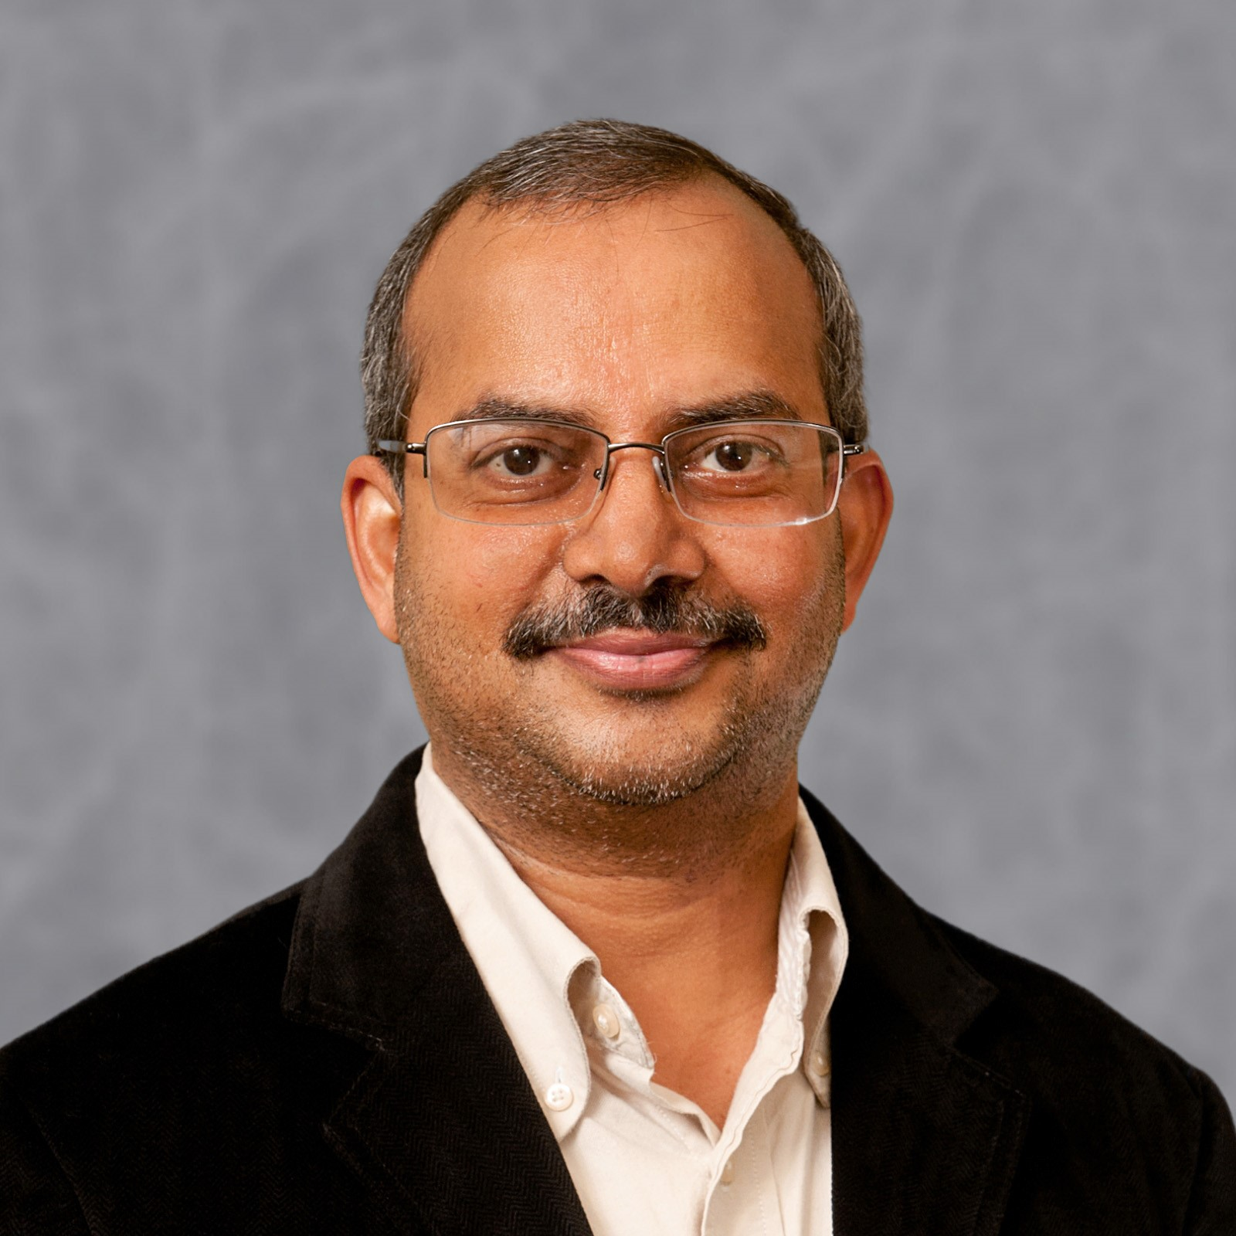
Introduction
Theme
Organizers
PC Members
Program
Future
Acknowledgement
Li Zhang
ICDM Workshop Co-chair
University of Texas Rio Grande Valley
Zhe Jiang
ICDM Workshop Co-chair
University of Florida
Ranga Raju Vatsavai
ICDM Workshop Co-chair
North Carolina State University

Slide 11
Introduction
Theme
Organizers
PC Members
Program
Future
Thank you!
See you at DMAIL 2026 @ICDM 2026

